Slide 1

Front Slide Option 1
BUS7C3 International Organisational Branding
Lecture 1 – Introductionn to the Module

Slide 2

Welcome!
Welcome everyone!
It is lovely to welcome you to Wrexham University and to this module.
Who am I?
I am your lecturer on this module, and we will be covering International Organisational Branding. I will talk a little more about this later in the lecture.

Slide 3
About the Module: How we will learn?
Firstly…. Important information.
During lectures there will be group work and student participation in this module, and you will be expected to contribute. It will be the fundamental aspect of how you will learn in this module.
You will be learning about this subject in a few different ways. Some of these ways include group work, class studies, break-out rooms, tutorials, videos, podcasts, academic journals and articles, self-study, core texts and wider reading.
You will be required to undertake self-study and active learning outside of the classroom. Your Moodle space will have learning materials that you are expected to access, which will also be factored into your classroom learning space. It is important you complete the tasks on your Moodle space, so that you can demonstrate your learning.
Classroom behaviour and classroom conduct will be professional. This is a safe space for everyone to participate in. We are all here to enjoy the classroom environment and to make learning a fun experience.

Slide 4

About The Module: Assessment Process
One group Assessment Portfolio – to cover all learning outcomes.
Weighted 100%
Due on the 16th Of May @ 16:00 UK time
Written submission – Word Document submitted to Turnitin
Formative assessment will take place throughout the module
Summative assessment will be submitted at the end of the module

Slide 5
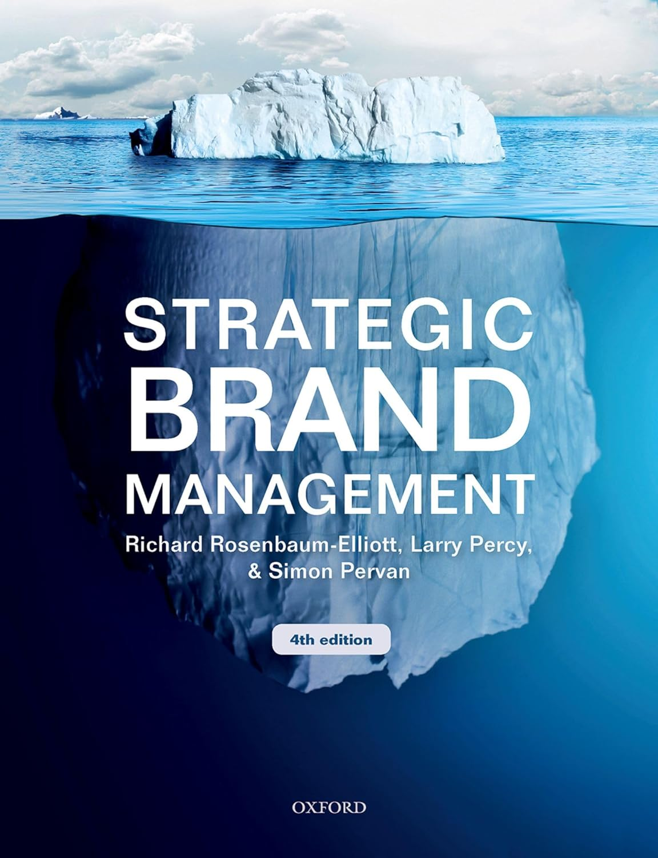
About the module: Core Textbook
Essential Read
Rosenbaum-Elliott, R., Percy, L. and Pervan, S. (2018) Strategic brand management. 4th edition. Oxford, Oxford University Press.

Slide 6
Other indicative reading
Benbunan, J., Schreier, G. and Knapp, B. (2019) Disruptive branding. How to win in times of change. London, Kogan Page.
Glanfield, K. (2018) Brand transformation: transforming firm performance by disruptive, pragmatic and achievable brand strategy. Abingdon, Routledge. Minsky, L. and Geva, I. (2019) Global brand management. London, Kogan Page.
Keller, K. and Swaminathan, V. (2019) Strategic brand management: building, measuring, and managing brand equity. 5th edition. Harlow, Pearson.

Slide 7
About the Module: Learning Outcomes
Critically discuss how branding is defined and positioned to add value to organisations.
Utilising contemporary literature, undertake a critical analysis of branding across a variety of different organisational strategies (e.g., marketing, HR).
Synthesise the global challenges and drivers that can impact negatively on branding across functions and formulate ways in which businesses can overcome these challenges through effective branding and brand management.
Critically discuss the relationship between branding and commercial drive, and people and customer-focused practices within national and international organisations.
Critically evaluate key insights into the effectiveness and improvement of branding within an international context.

Slide 8
Learning objectives – week 1
By the end of this week you should be able to:
Explain the difference between marketing and HR organisational branding.
Evaluate the role of branding within international organisations.
Describe the concept of branding from a people perspective.
Discuss the theory behind organisational branding from a HR perspective.

Slide 9
Activity 1: What is International Organisational Branding?
Everyone:
Taking a post it note, write down what you think international organisational branding is, and stick it on the front.
You have 5 minutes.

Slide 10
Activity 2: Is International Organisational Branding HRM or Marketing?
Everyone:
Revisit the post-it notes. Select one random note from the wall and decide whether it relates more to Human Resources (people and performance) or Marketing.
When you have decided – place it on the wall under the heading HRM or Marketing.
5 minutes.

Slide 11
Organisational Branding – what is it?
Branding is about establishing a company’s identity.
A company or corporate brand is about the bringing together of ideas, cultures, philosophies, and approaches to business to develop an identity both internally to the people who work within the company and externally to its customers and stakeholders.
It is about the promises made by the company to highlight the experience, value, quality of the service through its product and its people.
Brand image can suffer if these expectations are not met.

Slide 12
Organisational Branding – is it really HR?
Yes, it is. It is called employer branding.
Human Resources is a key role within organisational branding.
Why?
It is the culture and structure of an organisation’s beliefs and treatment of its employees in order to build its reputation as an employer of choice.
Embedded in human relations theory (Mayo, 1924, 1932). Focuses on employee satisfaction, and ways in which to influence/generate greater productivity.
There is a focus on people rather than machines. It focuses on key skills, such as communication. Communication takes place internally and externally.

Slide 13
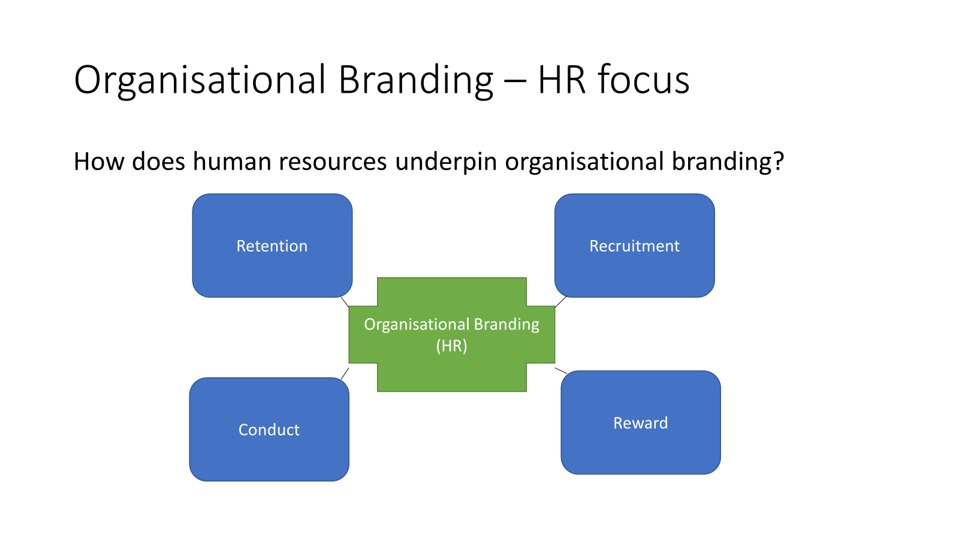
Organisational Branding – HR focus

Slide 14
Organisational Branding – Employer Branding
According to the CIPD, strong employer brand should connect an organisation’s values, people strategy and policies, and be linked to the company brand, (CIPD, 2022)
Main principles of HRM that connect to employer branding:
Retention - how we treat current employees to ensure we retain their skills.
Recruitment - how we treat perspective employees to ensure we capture the future skills we need.
Conduct - how we manage behaviours within the company to ensure people feel safe and respected.
Reward - how we value employees and recognise their contributions through tangible and intangible rewards.
Employer Branding - how we build credibility and portray the way in which we do all these things to the outside world – customers, stakeholders, competitors.

Slide 15
Organisational Branding - Retention
Retention - how we treat current employees to ensure we retain their skills.
Feeling supported and having a reasonable/manageable workload
Reduce turnover and turnover costs
Opportunities to develop both personally and within a chosen career
Good work life balance
Varied job role
Good leadership and management
Good company culture – boost employee morale
What happens if these are not met:
Employees become bored and may look for another job – outside of your company
Lack of support makes them feel vulnerable
Lack of development opportunities means they are unable to develop their career
Overworked leads to feelings of stress and anxiety
Leaders or managers are unsupportive
This means people will leave, taking with them their skills, competencies and capabilities, and leaving companies with a gap.

Slide 16
Organisational Branding – Retention
Retention relates to the social exchange theory (Homens, 1958).
Internal relationships v cost benefit analysis.
This means that from an organisational perspective, branding is key to enabling good relationships to develop between two or more people (teams etc), increasing morale through reward, and reducing recruitment costs and people turnover.
Creating a good workplace for people means they will 1) tell others, thereby increasing your brand value, 2) stay longer, particularly if the rewards are beneficial, and 3) produce good work.
This is about organisations providing opportunities for employees to drive decisions based on behaviour.

Slide 17
Organisational Branding - Recruitment
Recruitment - how we treat perspective employees to ensure we capture the future skills we need.
Organisation objectives and image, well-structured advert – highlighting all the benefits the company can offer.
Good recruitment process – making sure it is in line with any employment legislation.
Well-designed job roles and job descriptions so that new employees understand what is required of them and how they add value to the organisation.
Clear job requirements – i.e. qualifications, skills.
Excellent onboarding processes
What happens if this doesn’t happen?
Companies will not attract the right person for the job
Candidates do not have the right skills/qualifications for the job
New recruits may leave early meaning the company has to re-advertise the post

Slide 18
Organiational branding - Recruitment
Recruitment relates to equity theory (Adams, 1963).
Meaning the ‘distribution of resources is equitable and fair.’
Inputs they bring to the job, v outputs they gain (skills v pay, reward).
How employees behave and respond is relational to whether they feel under-rewarded or over-rewarded. Work and performance is related to pay.

Slide 19
Organisational Branding - Conduct
Conduct - how we manage behaviours within the company to ensure people feel safe and respected.
Health and Safety policies
Dignity at Work
Grievance and discipline
Codes of conduct – can include dress code
What happens if conduct is not managed within a company..
Employees do not feel safe or respected
They do not have a voice to raise any concerns
Employee behaviour is not managed internally, or managed out of the company (dismissal)

Slide 20
Organisational HR Branding - Reward
Reward - how we value employees and recognise their contributions through tangible and intangible rewards.
Tangible – something you can touch, i.e. money/pay. Intangible – something you feel, i.e. gratitude, good leadership, feeling valued.
Employee benefits and reward packages
Leadership and management
Performance appraisal management
Career development opportunities
If there is no reward…
Employees will feel undervalued
They will develop a transactional attitude
They will not give over and above – there will be no discretionary effort
They will seek recognition of their skills and value from another company (i.e. they will leave).

Slide 21
Organisational Branding - Theory
Human Relations Theory (Mayo, 1924, 1932)
Key principles for 2023!
Treat employees as individuals to increase motivation. Personalise it.
Develop initiatives to improve an employee’s circumstances inside and outside the organisation – reward and benefits (including pay).
Promote positive actions and relationships through organisational culture.
Ensure effective communication internally and externally

Slide 22
Organisational Employer Branding
Good processes, systems and policies for retention, recruitment, conduct and reward mean that companies will have happy, engaged and loyal employees, who will go above and beyond for the company because they feel valued and respected.
They will have a high level of job skills, and commitment to development.
In turn, this will mean they will be more productive, and provide better – even excellent customer service to the company’s customers and stakeholders resulting in greater company profit. (what Richard Branson’s video on this week’s Moodle space).

Slide 23
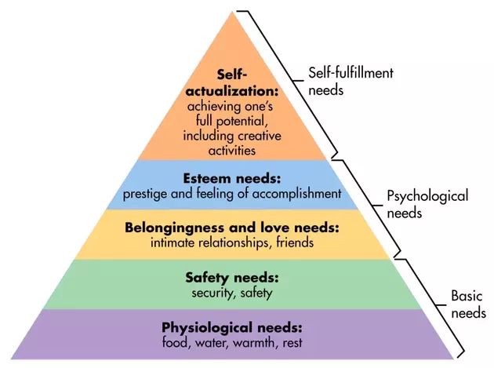
Organisational HR Branding - Theory
Maslow’s Hierarchy of Needs. Maslow (1954) stated that people are motivated to accomplish certain needs within their work life.

Slide 24
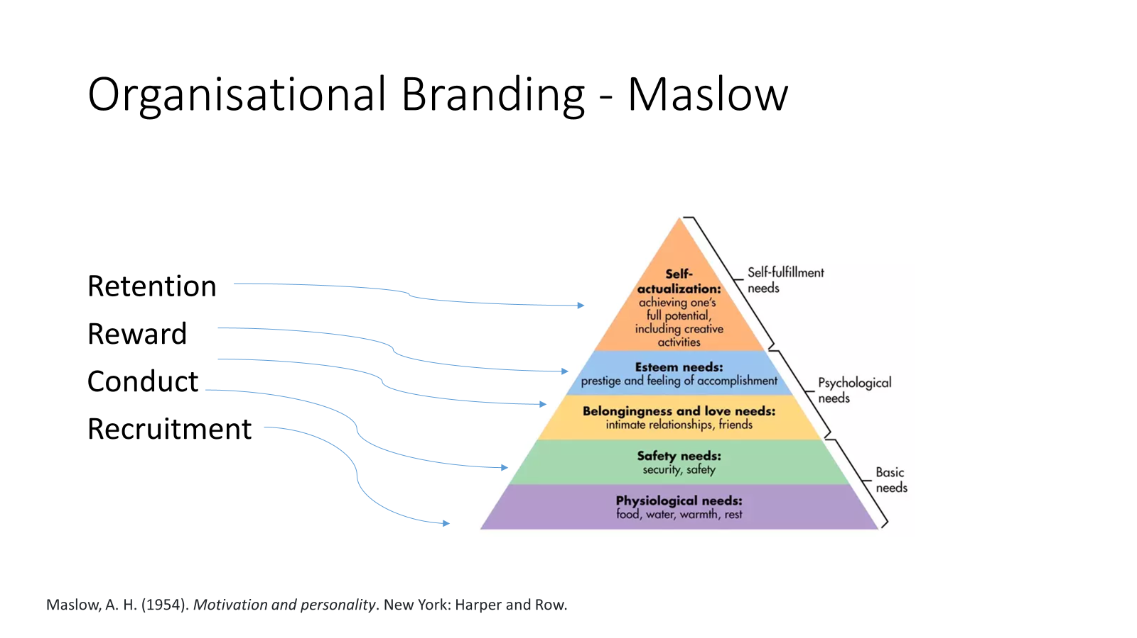
Organisational Branding - Maslow

Slide 25
Your own Research…
We have touched on a few points today within employer branding, HR and where this fits within international organisational branding.
In your groups - research the following in your groups and bring your findings to next week’s lecture. Leaders – you responsible for ensuring this task is completed.
Research the key points of human relations theory and bring them to the class next week for further discussion.

Slide 26

Thank you, very much!
Any questions ?

